Slide 1
Hacking The NES: Security of Embedded Systems
Nicolas Janis

Slide 2
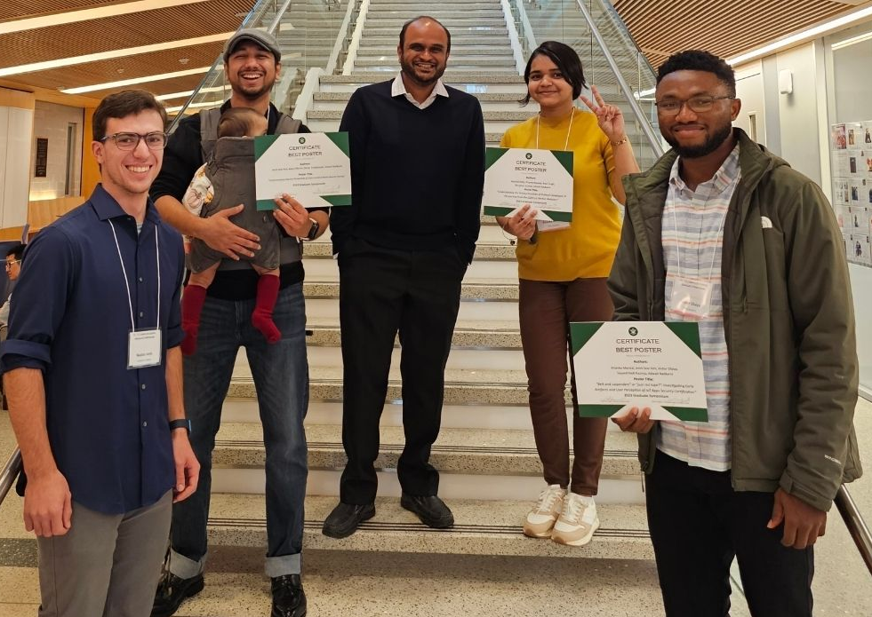
ABOUT ME
Nicolas Janis (Nicolas.d.Janis@gmail.com)
Student @ W&M
Technical Intern at ManTech
Member of SPL @ WM
GitHub: NDJSec (https://www.github.com/NDJSec)
Web: http://Nicolasjanis.dev/

Slide 3
TABLE OF CONTENTS
What is RE?
Embedded Software
Why the NES?
6502
Demo/Closing
What is Reverse Engineering?
How does embedded software change our perception?
Why choose the NES to learn embedded hacking?
What is the 6502?
Demo hacking the 6502 and questions.

Slide 4


01
What is RE?
Understanding the unknown

Slide 5

Reverse Engineering
The process of analyzing software to understand its functionality and purpose (ECCouncil)
Games (Video Game)
Malware (WannaCry)
Hardware (Phones, CCTV, The NES)
Mobile Apps (Android/IOS Apps)
Notes:
Mention industrial control systems

Slide 6
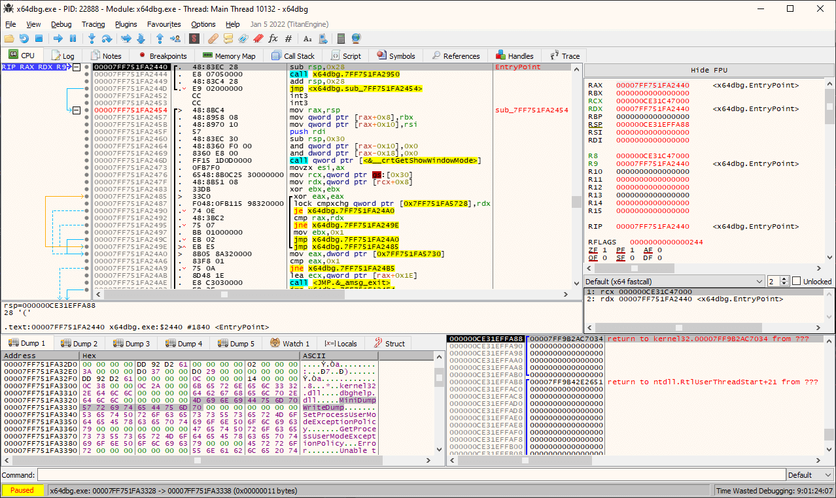
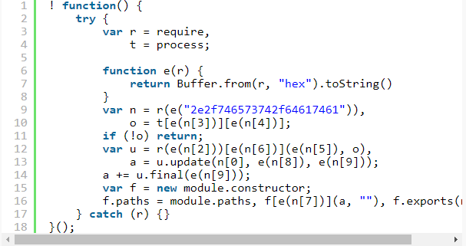
RE In the Wild

Slide 7

Story Time: 0x1

Slide 8

Compiled vs. Interpreted
Compiled
Converts Source code into machine code
Distributed via executables
Interpreted
Turned into an intermediate code (byte code)
Distributed via source code (Usually)

Slide 9
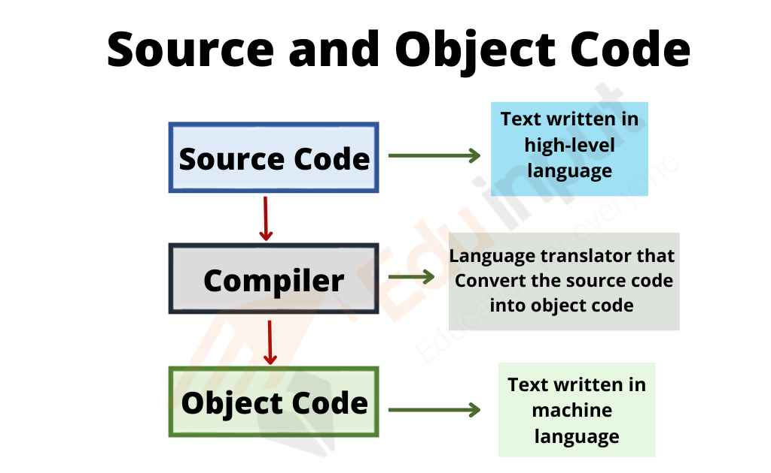
Object Code
Not human-readable
Raw hex files linked together to make an executable
Contains the operation code (Op codes) needed for the hardware to understand the code
The type of code we get in an executable

Slide 10
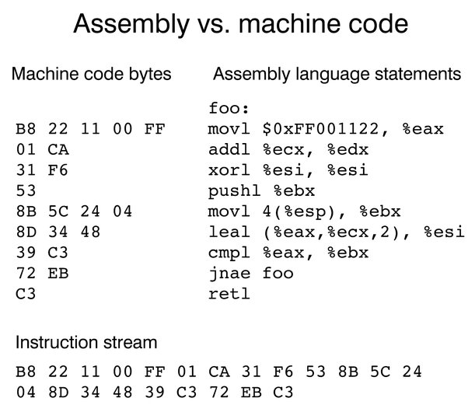
Assembly
Multiple “Flavors”
Lowest Level of human-readable code
Specific to the hardware architecture
Works on a stack-based system
x86/x86-64
ARM
MIPS

Slide 11
02
Embedded Software
The mystical land of ”bare-metal” ELFs and Unicorns

Slide 12

Embedded Software
Often no intermediary between you and the hardware
Otherwise no difference between embedded programming and non-embedded programming
Can have an OS or no OS

Slide 13
Embedded File Format
ELF
BIN
Executable and Linkable Format
Well defined
Memory Map in file
Depends on hardware
You are responsible for memory map (RE)
Notes:
ELF has symbols, BIN is usually stripped
Loaded offset missing in BIN

Slide 14
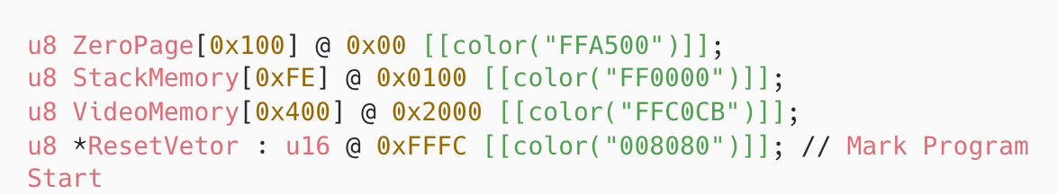
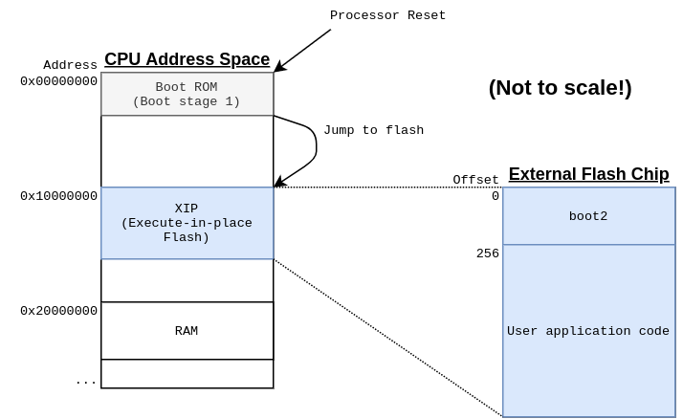

MEMORY MAP
Layout of everything on hardware
Program Code
Interrupts
I/O
Peripherals

Slide 15
03
NES
Old School Hacking

Slide 16

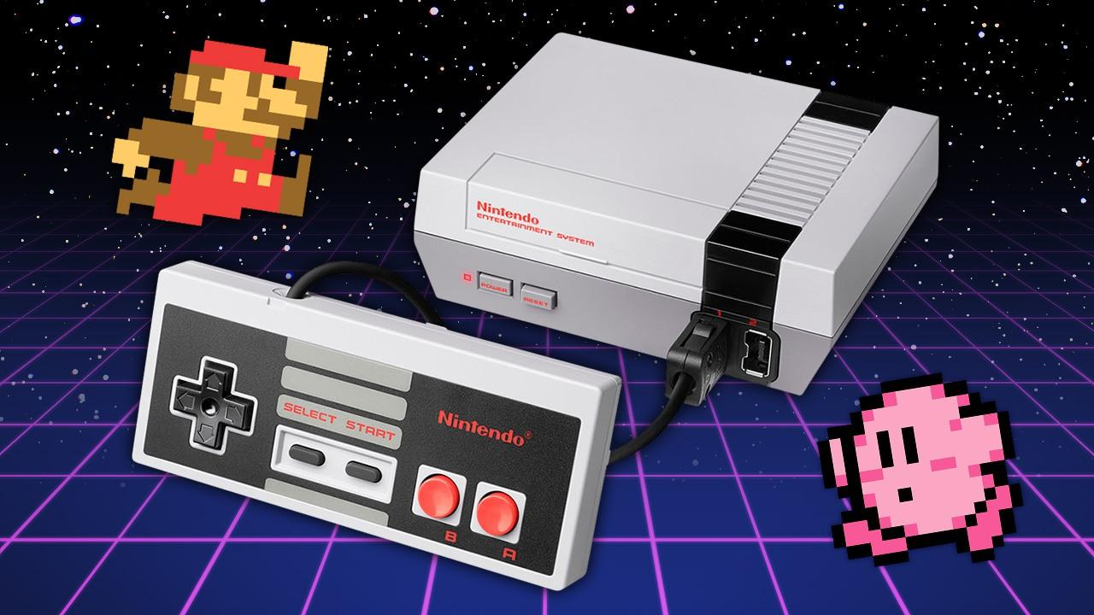
NES
Nintendo Entertainment System
1983
8-bit ”computer”
6502 based CPU
64Kb of RAM

Slide 17
LESSON
Layout of everything on hardware
Program Code
Interrupts
I/O
Peripherals

Slide 18
04
6502
Target Acquired

Slide 19
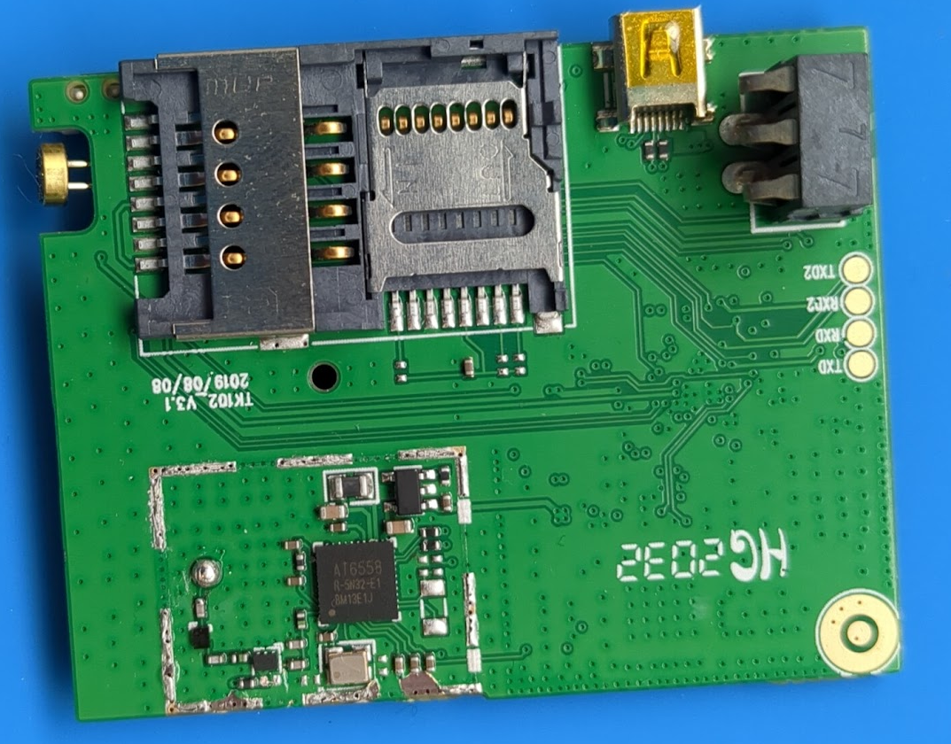
REAL-LIFE HARDWARE
INSTRUCTIONS
WHAT FIRST
WHAT CAN WE FIND?
How do we find instructions and memory map?
Where do we start?
What does the board tell us?

Slide 20
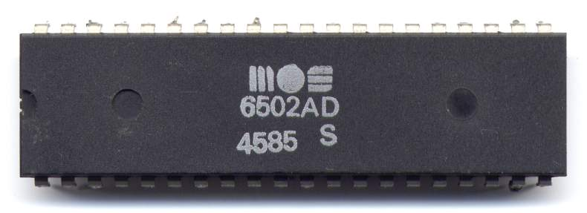
WHY THE 6502
INSTRUCTIONS
RAM
TYPE
There are 56 different instructions
64Kb of RAM
8-bit CPU

Slide 21
MUST KNOWS
ISR Table
INSTRUCTION SET
MEMORY MAP
ARCHITECTURE
Reset Vector
SVCall
NMI
x86/x86-64
ARM
MIPS
Where things live in memory
What architecture are you on
What does the system have access too

Slide 22
05
DEMO/Q&A
Let’s Hack + Questions!

Slide 23
REVIEW
What is RE?
Embedded Software
Why the NES?
6502
Learning the basics of RE
How embedded software effects us
NES for fun and profit
The key to the kingdom

Slide 24

YOUR TURN
6502 CTF Challenge [NDJSec]
Custom emulator
Hack the firmware
Unlock the cyber lock

Slide 25
THANKS!
Do you have any questions?
nicolas.d.janis@gmail.com
nicolasjanis.dev
Please keep this slide for attribution.

